Slide 1
Pro’s and Con’s of Trade Agreements
Alan V. Deardorff
For presentation to
District Export Council
November 9, 2016

Slide 2
Outline
Free Trade Agreements:
Their Essence
Their Economics
Their Proliferation
FTAs in Practice: More than FTAs
NAFTA (North American Free Trade Agreement
TPP (Trans-Pacific Partnership)
TTIP (Trans-Atlantic Trade and Investment Partnership)

Slide 3
The Essence of an FTA
Zero tariffs (import taxes) on all exports from partner countries
Pre-FTA tariffs on outside countries
Rules of origin to prevent trade deflection

Slide 4
Outline
Free Trade Agreements:
Their Essence
Their Economics
Their Proliferation
FTAs in Practice: More than FTAs
NAFTA
TPP
TTIP

Slide 5
The Economics of an FTA
Trade creation
Import from partner what you previously produced yourself
Trade diversion
Import from partner what you previously imported from outside

Slide 6
The Economics of an FTA
Trade creation
Beneficial to both countries in aggregate; similar to gains from true multilateral free trade
Harmful to domestic producers who sell less; also similar to true free trade

Slide 7
The Economics of an FTA
Trade diversion
Beneficial to partner country that now exports
Harmful to outside country that ceases exporting
Harmful to importing country, which imports higher-cost product
Does not harm domestic producers

Slide 8
The Economics of an FTA
Rules of Origin
Necessary for FTA
Reduce the economic gains from FTA
May be designed to restrict trade
May induce costly sourcing of inputs

Slide 9
Outline
Free Trade Agreements:
Their Essence
Their Economics
Their Proliferation
FTAs in Practice: More than FTAs
NAFTA
TPP
TTIP

Slide 10
The Proliferation of FTAs
Called “Regional Trade Agreements” by WTO
There were very few until the 1990.
Their numbers have grown

Slide 11
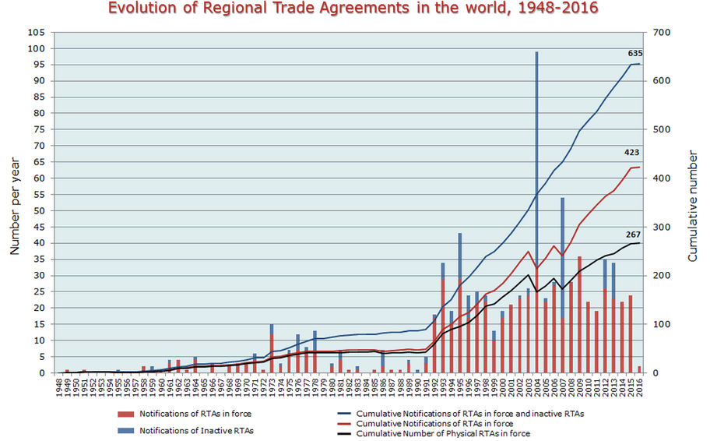

Slide 22
Outline
Free Trade Agreements:
Their Essence
Their Economics
Their Proliferation
FTAs in Practice: More than FTAs
NAFTA
TPP
TTIP

Slide 23
FTAs in Practice: NAFTA
NAFTA = North American Free Trade Agreement
A Free Trade Agreement including US, Canada, and Mexico
Zero tariffs on (taxes on imports from) each other
Pre-existing tariffs on outside countries
Rules of origin

Slide 24
NAFTA – What is it?
Other provisions
Some liberalization in services
Foreign investment
ISDS in Chapter 11
Intellectual property rights
Opening of government procurement

Slide 25
NAFTA – What is it?
Side Agreements
Labor
Environment

Slide 26
NAFTA - History
Before NAFTA, US had
US-Canada Auto Pact
Signed 1965
Free trade between US and Canada in cars and car parts

Slide 27
NAFTA - History
Before NAFTA, US had
US-Canada FTA
1989
Prompted by
US frustration with multilateral negotiations
Canadian frustration with US AD and CVD policies

Slide 28
NAFTA - History
Before NAFTA,
Mexico had
High tariffs, like most developing countries
Had begun to reduce them in 1980s
Even after reductions, Mexican tariffs were much higher than US tariffs

Slide 29
NAFTA - History
Before NAFTA,
Maquiladora Arrangements with Mexico
Low tariffs on US imports from Mexico of goods processed there from US inputs
Initially restricted to border region

Slide 30
NAFTA - History
NAFTA Negotiations
Done by Bush (Sr.) administration, 1991-2
Extended US-Canada FTA to include Mexico
Agreement was reached under Bush, but was not yet approved by Congress before 1993

Slide 31

NAFTA - Debate
Those opposed (around 1992 election)
Labor unions (feared lost jobs and lower wages)
Some environmental groups (feared dirty industries)
Ross Perot (ran for president)
Feared firms would move to Mexico:
“Great sucking sound”
Some Democrats

Slide 32
NAFTA - Debate
Those in favor
Bush (Sr.) administration
Clinton (Bill) (but with reservations about labor and environment)
Most of the business community
Most economists (Not all)

Slide 33
NAFTA - History
After Clinton won election
Clinton negotiated Side Agreements on Labor and Environment
NAFTA was approved (very narrowly) by Congress Nov 1993

Slide 34
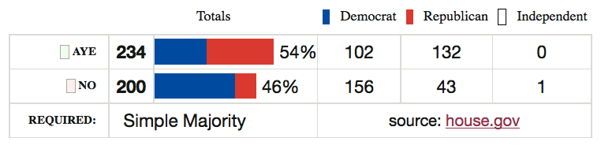
NAFTA - History
Jan 1, 1994: NAFTA took effect

Slide 35
NAFTA - History
What happened?
Not much, at first
Then, almost a year later, the “Peso Crisis”

Slide 36
Peso Crisis (aka “Tequila Crisis”)
Mexico’s exchange rate was pegged
Mexico resisted depreciation during 1994 due to presidential election
Two assassinations also in 1994
Late 1994 (after election)
Crisis hit
Peso devalued
Devaluation had devastating effects on the Mexican economy

Slide 37
Reserves Fell at Once
What Happened: Mexico
NAFTA
Peso Crisis

Slide 38
What Happened: Mexico
Peso Dropped One Year After
NAFTA
Mexico Exchange Rate
Peso Crisis
Quarterly 1988-2004
0.5
0.4
$/peso
0.3
0.2
0.1
0
Q1 1988
Q2 1989
Q3 1990
Q4 1991
Q1 1993
Q2 1994
Q3 1995
Q4 1996
Q1 1998
Q2 1999
Q3 2000
Q4 2001
Q1 2003
Q2 2004
Notes:
Source of data in slide and following: IMF IFS online

Slide 39
GDP Fell after Peso Crisis
What Happened: Mexico
NAFTA
Mexico Real GDP
Peso Crisis
1993=100
160
140
120
100
80
60
40
20
0
Q1 1988
Q2 1989
Q3 1990
Q4 1991
Q1 1993
Q2 1994
Q3 1995
Q4 1996
Q1 1998
Q2 1999
Q3 2000
Q4 2001
Q1 2003
Q2 2004

Slide 40
Imports Fell after Crisis; Exports Rose
What Happened: Mexico
NAFTA
Peso Crisis

Slide 41
Wages Fell
What Happened: Mexico
NAFTA
Peso Crisis

Slide 42
Real Wages Plummeted!
What Happened: Mexico
NAFTA
Peso Crisis

Slide 43
Unemployment: No effect (or fell)
What Happened: U.S.
NAFTA
Peso Crisis

Slide 44
Trade: Continued growth
What Happened: U.S.
NAFTA
Peso Crisis

Slide 45
Real Wage: No Change
What Happened: U.S.
NAFTA
Peso Crisis

Slide 46
Grew: More To US than From
What Happened: Trade
NAFTA
Peso Crisis

Slide 47
What has happened since?
US Trade
With NAFTA partners has continued to grow
Deficit grew much larger until 2008
But much of the imports was oil

Slide 48
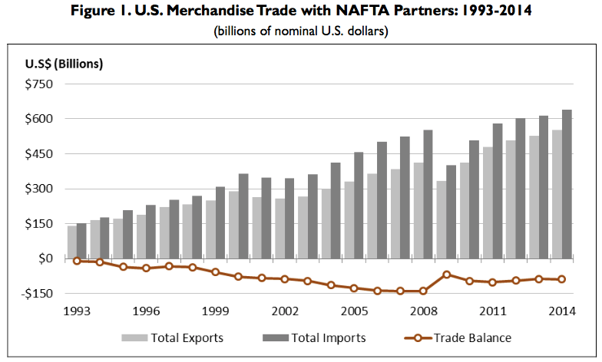
Source: Congressional Research Service (2015)

Slide 49
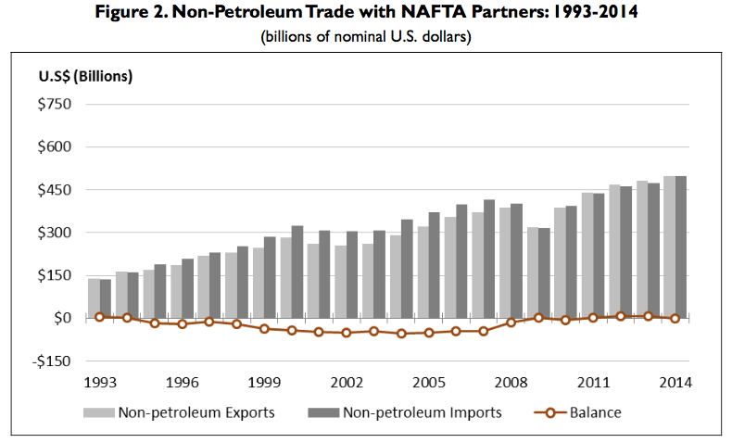
Source: Congressional Research Service (2015)

Slide 50
NAFTA Analyses: Before
Many studies examined likely effects
Some, from both sides of the debate, used spurious analysis to support their views
Example: All imports from Mexico are viewed as costing jobs
On the positive side, advocates of NAFTA did the same with US exports, presumed to rise a lot because of Mexico’s high tariffs

Slide 51
NAFTA Analyses: Before
Best academic studies (including our “Michigan Model”) predicted
Positive, but very small, benefit to the US
Negligible disruption of US labor markets
Positive, somewhat larger, benefit to Mexico
Significant disruption in some Mexican markets
Nobody predicted Peso Crisis

Slide 52
NAFTA Analyses: Before
Reasons for small predicted effects on US
US MFN tariffs were already very low
Much trade with Mexico was already at even lower tariffs, under Maquiladora system
US trade with Mexico was big, but not all that big, compared to size of US economy

Slide 53
NAFTA Analyses: Before
The Main Issue that Raised Concern
Mexican wages were only about 1/10 of US wages
Seemed obvious to many (e.g., Ross Perot) that employers would move to Mexico
Answer
Mexican wages were low for a reason: low productivity
If this had not been true, jobs would already have moved, given our already low tariffs

Slide 54
NAFTA Analyses: After
Krueger (2000) analyzed the data up through 1997 (thus very early) and concluded that
The large expansion in US-Mexico trade was probably mostly trade creating
It was too soon for a final verdict, but NAFTA was probably beneficial overall

Slide 55
NAFTA Analyses: After
Romalis (2005)
Welfare effects close to zero for US, Canada, and Mexico
Several signs of trade diversion

Slide 56
NAFTA Analyses: After
Caliendo and Parro (2015)
Updated earlier studies with more recent analytical tools
Found welfare benefits for US and Mexico but loss for Canada

Slide 57
Welfare effects from NAFTA’s tariff reductions
 | Welfare
Country | Total | Terms of Trade | Volume of Trade | Real Wages
Mexico | 1.31% | –0.41% | 1.72% | 1.72%
Canada | –0.06% | –0.11% | 0.04% | 0.32%
U.S. | 0.08% | 0.04% | 0.04% | 0.11%
Source: Caliendo and Parro (2015), Table 2

Slide 58
NAFTA Analyses: After
Posen (2014)
“For every 100 jobs US manufacturers created in Mexican manufacturing, they added nearly 250 jobs at their larger US home operations”
Unemployment in US was actually lower after NAFTA than before (until the 2008 financial crisis)
Critics say NAFTA cost 45,000 jobs a year.
That may be true
But this is only 0.1% of normal job turnover in the US, where 4m-6m workers leave or lose jobs per month)

Slide 59
NAFTA Analyses: After
Hakobyan and McLaren (2016)
They look for effects on local labor markets, where
industries
and/or communities
were vulnerable to large tariff cuts against Mexico
They find
Substantial variation across localities

Slide 60
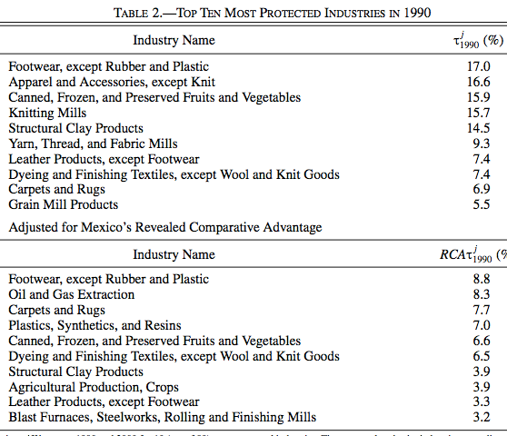
Source: Hakobyan and McLaren (2016)

Slide 61
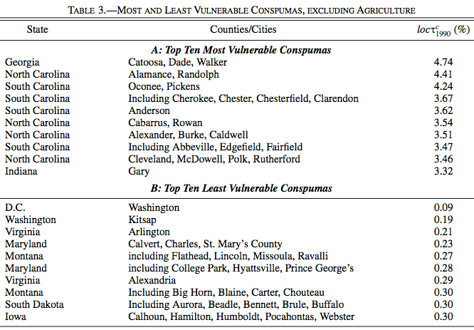
(Consistent Public-Use Microdata Areas)
Source: Hakobyan and McLaren (2016)

Slide 62
NAFTA Analyses: After
Hakobyan and McLaren (2016)
“The fact that both the location and the industry effects hit blue-collar workers, especially high school dropouts, but not college graduates suggests the possibility that the costs of moving or of switching industries are larger for less educated workers, so that more educated workers can adjust more easily and arbitrage wage differences away.”

Slide 63
NAFTA Analyses: After
Hakobyan and McLaren (2016)
“…even workers in a nontraded industry—waiting on tables in a diner, for example—saw a sharp reduction in wages if they were in a vulnerable location that lost its protection quickly.”

Slide 64
NAFTA Analyses: After
Disruption of some industries and localities
Was expected
May have been larger than expected
Has not been dealt with adequately by TAA
Nonetheless was still small
But provides easy ammunition for critics

Slide 65
NAFTA Analyses: After
What to do?
Renegotiate NAFTA (Trump)?
Not clear what to change
Raising tariffs now would be much more disruptive than NAFTA ever was

Slide 66
NAFTA Analyses: After
What to do?
Find better policies to assist workers displaced by both trade and technology
Wage insurance
Better social safety net

Slide 67
Outline
Free Trade Agreements:
Their Essence
Their Economics
Their Proliferation
FTAs in Practice: More than FTAs
NAFTA
TPP
TTIP

Slide 68
FTAs in Practice: TPP
TPP = Trans-Pacific Partnership
A Free Trade Agreement including US and 11 other countries
Includes Japan
Does not include China

Slide 69
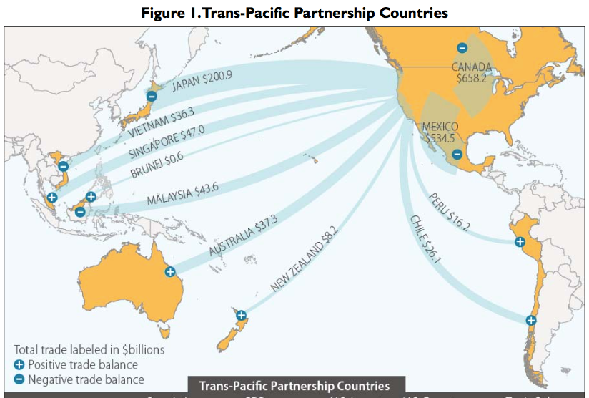
X?

Slide 70
What Is the TPP?
Main Features of TPP (only a few of 30 chapters):
Trade in goods: Reduce/remove tariffs & NTBs
Trade in services: Reduce/remove barriers
Digital trade: Facilitate data flows and E-commerce
Investment: Investor/State Dispute Resolution
Intellectual property: Expanded patents, etc.
Labor: Enforcement of standards
Environment: Enforcement of standards
State-owned firms: Competitive neutrality
Currency manipulation? (No, but side agreement)

Slide 71
What Is the TPP?
I will first look at each of these briefly:
What they do.
Who will gain and lose as a result.
I will then mention several of the most contentious issues,
How they were resolved, and
In whose favor.

Slide 72
Trade in Goods
Trade in goods: Reduce/remove tariffs & NTBs on 11,000 products among TPP countries
Most US tariffs (average 3.4%) fall to zero.
Most tariffs faced by US exports fall to zero:
Brunei 2.5%
Japan 4.9%
Malaysia 6.0%
New Zealand 2.0%
Vietnam 9.5%
Exception: Some agriculture
Other policies and regulations that restrain trade will be harmonized or removed.
Schedules and rates differ by exporting country

Slide 73
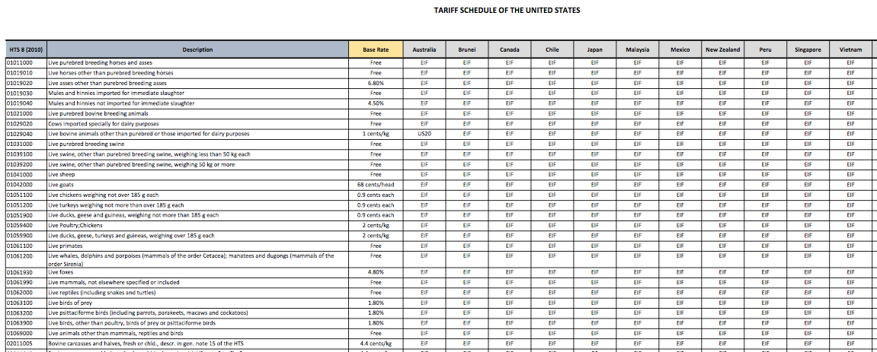

Slide 74
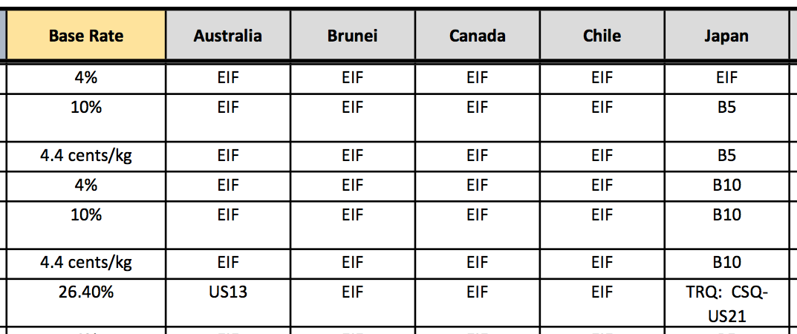
EIF: Entry In Force (duty-free from start)
B5: Eliminated in 5 annual stages, duty-free in year 5
B10: Eliminated in 10 annual stages, duty-free in year 10
Bovine Meat Cuts (i.e., Beef)
US21: No higher that Peru FTA
US13: Base rate until 2022; duty-free in 2022

Slide 75
Trade in Goods
Who Gains?
US consumers as a whole, from cheaper goods
US exporters (firms, workers) benefit
Most agriculture (grains, meat)
Airplanes
Who Loses?
US government from lost tariff revenue (small)
US import competitors (firms, workers) lose
Autos (but not soon)
Some agriculture (sugar)
Textiles, apparel, footwear

Slide 76
Trade in Goods
Dairy?
More exports to Canada, but
More imports from New Zealand.
Cars and Trucks?
Yes, due to imports from Japan, with inputs from China.
Note though: US tariffs on…
Cars: 2.5%, removal phased in over 25 years.
Trucks: 25%, removal phased in over 30 Years.

Slide 77
Trade in Services
Trade in services: Reduce/remove barriers among TPP countries
Remove restrictions on service providers (most restrictive in poorer countries).
Financial services (banks, insurance)
Professional services (legal, educational)
Telecommunications
Express delivery
E-commerce
Facilitate international movement of persons working temporarily in firms if needed for other aspects of TPP commitments.

Slide 78
Trade in Services
Who Gains?
US is very competitive in services, and most industries (firms, workers) will do well, as will other developed countries
There may be some concern about allowing more visas for temporary foreign workers.
Who Loses?
Developing countries expect to lose from this competition with their service firms, although their buyers will gain.

Slide 79
Digital Trade
Digital trade: Facilitate data flows and E-commerce
Bars customs duties on digital products
Prevents blocking of cross-border data flows
Prohibits forced localization of data centers
(Some exceptions permitted.)

Slide 80
Digital Trade
Who Gains?
America’s digital companies
Consumers of digital services
Who Loses?
Weaker digital competitors
Countries concerned about privacy

Slide 81
Investment
Investment:
Right of establishment
Transfer of payments out of host country
Investor-State Dispute Settlement (ISDS) to prevent expropriation or “indirect expropriation”
Allows foreign investors to seek international arbitration to settle disputes with host governments

Slide 82
Investment
Who Gains?
Multinational corporations
Who Loses?
Governments at all levels that seek to regulate for legitimate purposes
But Note: TPP “reaffirms a country’s right to regulate in the public interest” (including public health, safety, and environment)
Notes:
CRS Nov 2015

Slide 83
Intellectual Property
Intellectual Property: Expanded patents, etc.
Expand IP protection beyond that already covered in the WTO
Extend copyright protection from 50 to 70 years from death of author
Criminal penalties for copyright violation and for theft of trade secrets
Extend period of data exclusivity on some types of medicines, esp. biologics

Slide 84
Intellectual Property
Who Gains?
Owners of IP
Pharmaceutical firms
Movie and music companies
Who Loses?
Consumers of IP
Especially patients in developing countries

Slide 85
Labor
Labor: Enforcement of labor standards
ILO Core Labor Standards (not enforced by ILO)
Freedom of association and collective bargaining
Elimination of compulsory or forced labor
Abolition of child labor
Elimination of discrimination
TPP will require countries to enforce these, plus “acceptable conditions of work”
Minimum wage
Hours of work
Occupational safety and health
Violation will be subject to TPP dispute settlement
Notes:
TPP, p. 19-1

Slide 86
Labor
Who Gains?
Labor unions and workers in high-income countries, as well as their employers who compete with low cost labor
Who Loses?
Workers* and firms in low-wage countries of the TPP, whose costs rise and competitiveness declines.
*But note: workers there who keep their jobs will be paid more and treated better.

Slide 87
Environment
Environment: Enforcement of standards
US was pushed to include:
Enforcement of domestic environmental laws and multilateral agreements
Prohibition of relaxing rules to encourage trade or investment
Provisions to combat: wildlife trafficking, illegal logging and fishing, fishing subsidies
Stakeholder participation
Much of this is included in TPP, together with mechanisms for enforcement.
Notes:
http://www.nytimes.com/2015/10/06/business/environmentalists-praise-wildlife-measures-in-trans-pacific-trade-pact.html?ref=todayspaper

Slide 88
Environment
Who Gains?
The environment and environmentalists.
Rich countries who would have such laws anyway.
The world, if this helps fight global problems
Who Loses?
Those who traffic illegally.
Poor countries whose competitiveness may depend on weak environmental regulation.
Notes:
http://www.nytimes.com/2015/10/06/business/environmentalists-praise-wildlife-measures-in-trans-pacific-trade-pact.html?ref=todayspaper

Slide 89
State-Owned Enterprises
State-Owned Enterprises (SOEs): Achieve “competitive neutrality”
Addresses commercial disadvantages of private firms competing with SOEs
Requires transparency and reporting
Prohibits noncommercial assistance to SOEs that adversely impacts others

Slide 90
State-Owned Enterprises
Who Gains?
Countries with few SOEs, and their private firms that will compete with SOEs elsewhere
Who Loses?
Those who have – and want to retain & give advantages to – large numbers of SOEs
Examples:
Vietnam (40% of output), Malaysia, Singapore
US, with Fannie Mae and US Postal Service
Note: SOEs are often inherently costly, and some countries may welcome a requirement to stop supporting them

Slide 91
Contentious Issues
Several Issues threatened to derail the negotiations and were resolved only at the last minute:
Biologic Drugs
Dairy Products
Auto Parts
Japanese Agriculture: Rice, Pork and Beef
ISDS
Exchange Rates

Slide 92
Contentious Issues: Biologics
Biologic Drugs
(advanced medicines made from living organisms)
The issue:
Time period of permitted data secrecy
US wanted 12 years of protection, as contained in the Affordable Care Act. Japan also favored long period of protection.
Australia and others wanted much shorter protection, 5 or 6 years, so as to speed the development of generics and reduce costs.
Notes:
WSJ: http://blogs.wsj.com/briefly/2015/10/05/5-challenges-at-the-trans-pacific-partnership-negotiations/

Slide 93
Contentious Issues: Biologics
Resolution:
“The compromise set a mandatory minimum of five years, without setting a maximum, leaving both sides to declare victory.” (NYT, Oct 6, 2015)
US will keep it’s 12-years of protection, but others will not. 5 years protection will be an increase for some countries.
Who Won?
Australia and others.
Result: Big Pharma will lobby against TPP.
Notes:
WSJ: http://blogs.wsj.com/briefly/2015/10/05/5-challenges-at-the-trans-pacific-partnership-negotiations/

Slide 94
Contentious Issues: Dairy
Dairy Products
Exporters (New Zealand, U.S.) wanted reduced barriers into protected markets such as Canada and Japan
New Zealand also wanted increased exports into U.S.
Canada resisted because of its dairy support program.
Notes:
http://blogs.wsj.com/briefly/2015/10/05/5-challenges-at-the-trans-pacific-partnership-negotiations/

Slide 95
Contentious Issues: Dairy
Resolution:
Some expanded imports into Canada and US was agreed via
Expanding tariff-rate quotas
Some lowered tariffs
Who Won?
Not clear. Probably nobody got what they wanted.
Notes:
http://blogs.wsj.com/briefly/2015/10/05/5-challenges-at-the-trans-pacific-partnership-negotiations/

Slide 96
Contentious Issues: Auto Parts
Auto Parts
Issues are
Tariffs and other barriers into both US and Japan
US has 25% tariff on trucks (& only 2.5% on cars)
Japan has non-tariff barriers
Rule of Origin for cars and car parts:
Japan wanted it low, to permit it to include inputs from non-TPP countries such as Thailand and China.
Mexico wanted it at least 50%, to preserve the advantage over those countries that it has in NAFTA, where it is effectively 53-55%.
Notes:
http://blogs.wsj.com/briefly/2015/10/05/5-challenges-at-the-trans-pacific-partnership-negotiations/
http://www.nytimes.com/2015/10/06/business/international/what-changes-lie-ahead-from-the-trans-pacific-partnership-pact.html?ref=todayspaper

Slide 97
Contentious Issues: Auto Parts
Resolution:
Long phase-outs of US tariffs: trucks 30 years, cars 25, auto parts up to 15
45 percent TPP content for cars & light trucks to qualify for preference
Who Won?
It appears that Japan got what it wanted
Who Lost?
Mexico and perhaps US car companies
Notes:
http://www.nytimes.com/2015/10/06/business/international/what-changes-lie-ahead-from-the-trans-pacific-partnership-pact.html?ref=todayspaper
“United States and Japan agreed to long periods before American tariffs on Japanese vehicles sold in this country are phased out — 30 years for trucks, 25 for autos, and up to 15 years for some auto parts.” (NYT Oct 5, 2015)
“45 percent of the value of each car or light truck will need to be produced in a Trans-Pacific Partnership country for the vehicle to be charged little or no duty by customs officials.” (NYT Oct 5, 2015)

Slide 98
Contentious Issues: Japanese Ag.
Rice, Pork, and Beef
Japan has had a prohibitive tariff on imports of rice, protecting rice farmers who are important supporters of Japan’s ruling Liberal Democratic Party.
US and Australia are major exporters of rice and want access into Japan
Pork and beef are similar to rice but less so: Japan has high tariffs, which the U.S. wants it to reduce.
Notes:
http://blogs.wsj.com/briefly/2015/10/05/5-challenges-at-the-trans-pacific-partnership-negotiations/“45 percent of the value of each car or light truck will need to be produced in a Trans-Pacific Partnership country for the vehicle to be charged little or no duty by customs officials.” (NYT Oct 5, 2015)

Slide 99
Contentious Issues: Japanese Ag.
Resolution:
Japan will lower its tariff on beef from over 38.5% to 9% over 16 years
Pork tariff will fall from 4.3% to 2.2%, but will also lower minimum import price from ¥482/kg to ¥125, and later to ¥50.
Rice: New duty-free quota of 50,000 tons, rising to 75,000 tons in year 13
Notes:
http://blogs.wsj.com/briefly/2015/10/05/5-challenges-at-the-trans-pacific-partnership-negotiations/

Slide 100
Contentious Issues: Japanese Ag.
Who won?
Japanese consumers of meat
US and other producers of meat and rice
Japanese rice farmers, as high tariff continues
Who lost?
Japanese beef and pork farmers
Japanese government, which will collect less tariff revenue on both meat and rice
Notes:
http://blogs.wsj.com/briefly/2015/10/05/5-challenges-at-the-trans-pacific-partnership-negotiations/

Slide 101
Contentious Issues: ISDS
ISDS: Investor-State Dispute Settlement
This gives multinational firms leverage over governments to resist policies that reduce their profits
Most objected-to have been actions by tobacco companies that use trade agreements to block cigarette labeling requirements

Slide 102
Contentious Issues: ISDS
Resolution:
Cigarette companies will not have access to ISDS.
No other weakening of ISDS
Who Won?
US companies (drugs, music, film) other than tobacco
Who Lost?
Tobacco
Environmentalists and other advocates of government intervention

Slide 103
Contentious Issues: Exchange Rates
Exchange Rates
Many in US wanted TPP to address currency undervaluation (which makes exports cheaper)
Most other TPP countries opposed this, as did the Obama administration
Countries often accused of currency manipulation include Japan and China.
Notes:
http://www.nytimes.com/2015/10/06/business/international/what-changes-lie-ahead-from-the-trans-pacific-partnership-pact.html?ref=todayspaper

Slide 104
Contentious Issues: Exchange Rates
Resolution: Side Agreement on Exchange Rates:
Commitment to avoid manipulation
Transparency and Reporting
Group to meet at least annually to discuss macroeconomic and exchange rate issues
No enforcement mechanism
Who Won?
International economists and experts on macro/monetary policy
Who Lost?
Ford Motor Co. and other vocal advocates of response to exchange rate manipulation
Notes:
http://www.nytimes.com/2015/10/06/business/international/what-changes-lie-ahead-from-the-trans-pacific-partnership-pact.html?ref=todayspaper

Slide 105
Contentious Issues and Their Resolutions
In each case, there were losers and winners, usually both in each country.
Losers may now oppose the TPP.
Thus support for TPP is reduced, and getting it past US Congress will be problematic.
Notes:
http://www.nytimes.com/2015/10/06/business/international/what-changes-lie-ahead-from-the-trans-pacific-partnership-pact.html?ref=todayspaper

Slide 106
What’s Next?
TPP must be approved by the political process in each of the 12 countries, which may be most problematic in the US.
Congress – both houses – will have to accept or reject it by a simple majority up-or-down (no amendments) vote.
Decisions were unlikely during US presidential campaign.
Obama has been pushing for vote by “lame ducks”

Slide 107
Outline
Free Trade Agreements:
Their Essence
Their Economics
Their Proliferation
FTAs in Practice: More than FTAs
NAFTA
TPP
TTIP

Slide 108
FTAs in Practice: TTIP
TTIP = Trans-Atlantic Trade and Investment Partnership
Trade agreement between US and EU
Still being negotiated and may not succeed

Slide 109
TTIP
What TTIP Includes
Still unknown
Tariff reduction, but these are already small
Harmonization of rules and regulations
Investment dispute resolution

Slide 110
TTIP
Concerns
That concerns for environment will be undermined
That corporations will get greater power over governments

Slide 111
Conclusion
Free Trade Agreements
Have been & would be beneficial overall
They also include problematic features
And trade always, while helping overall, is costly to some

